Slide 1
Advanced Openacc Course
Lecture 2: Advanced Multi-GPU Programming, May 26, 2016

Slide 2
Course Objective: Enable you to scale your applications on multiple GPUs and optimize with profiler tools

Slide 3
May 19: Advanced Profiling of OpenACC Code
May 26: Office Hours
June 2: Advanced multi-GPU Programming with MPI and OpenACC
Course Syllabus
Recordings:
https://developer.nvidia.com/openacc-advanced-course

Slide 4
Advanced multi-GPU Programming with MPI And Openacc
Lecture 2: Jiri Kraus, NVIDIA

Slide 5
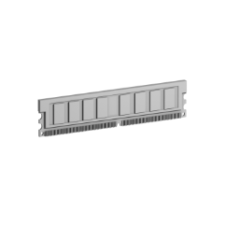



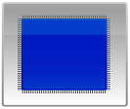
MPI+OPenACC
System
Memory
System
Memory
System
Memory
GDDR5
Memory
GDDR5
Memory
GDDR5
Memory
…
GPU
CPU
GPU
CPU
GPU
CPU
PCI-e
PCI-e
PCI-e
Network
Card
Network
Card
Network
Card
Node 0
Node 1
Node n-1

Slide 6
MPI+OPenACC
System
Memory
System
Memory
System
Memory
GDDR5
Memory
GDDR5
Memory
GDDR5
Memory
…
GPU
CPU
GPU
CPU
GPU
CPU
PCI-e
PCI-e
PCI-e
Network
Card
Network
Card
Network
Card
Node 0
Node 1
Node n-1

Slide 7
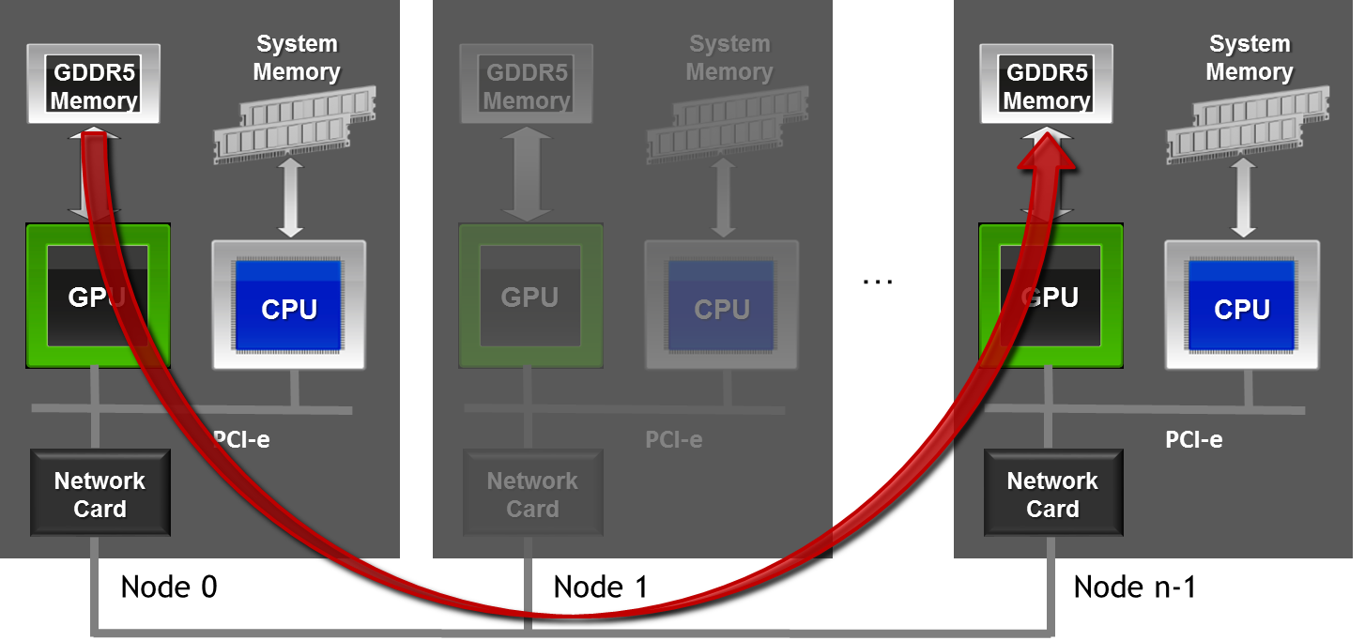
MPI+OPenACC
//MPI rank 0
#pragma acc host_data use_device( sbuf )
MPI_Send(sbuf, size, MPI_DOUBLE, n-1, tag, MPI_COMM_WORLD);
//MPI rank n-1
#pragma acc host_data use_device( rbuf )
MPI_Recv(rbuf, size, MPI_DOUBLE, 0, tag, MPI_COMM_WORLD, MPI_STATUS_IGNORE);

Slide 8
Using MPI for inter GPU communication
Debugging and Profiling of MPI+OpenACC apps
Multi Process Service (MPS)
Decreasing parallel overhead
Agenda

Slide 9
Using MPI for inter GPU communication

Slide 10
Message Passing Interface - MPI
Standard to exchange data between processes via messages
Defines API to exchanges messages
Point to Point: e.g. MPI_Send, MPI_Recv
Collectives: e.g. MPI_Reduce
Multiple implementations (open source and commercial)
Bindings for C/C++, Fortran, Python, …
E.g. MPICH, OpenMPI, MVAPICH, IBM Platform MPI, Cray MPT, …

Slide 11
MPI - Skeleton
#include <mpi.h>
int main(int argc, char *argv[]) {
int rank,size;
/* Initialize the MPI library */
MPI_Init(&argc,&argv);
/* Determine the calling process rank and total number of ranks */
MPI_Comm_rank(MPI_COMM_WORLD,&rank);
MPI_Comm_size(MPI_COMM_WORLD,&size);
/* Call MPI routines like MPI_Send, MPI_Recv, ... */
...
/* Shutdown MPI library */
MPI_Finalize();
return 0;
}

Slide 12
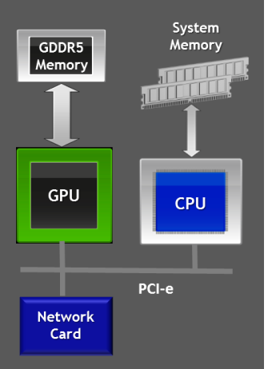
MPI
Compiling and Launching
$ mpicc -o myapp myapp.c
$ mpirun -np 4 ./myapp <args>
rank = 0
rank = 1
rank = 2
rank = 3
myapp
myapp
myapp
myapp

Slide 13
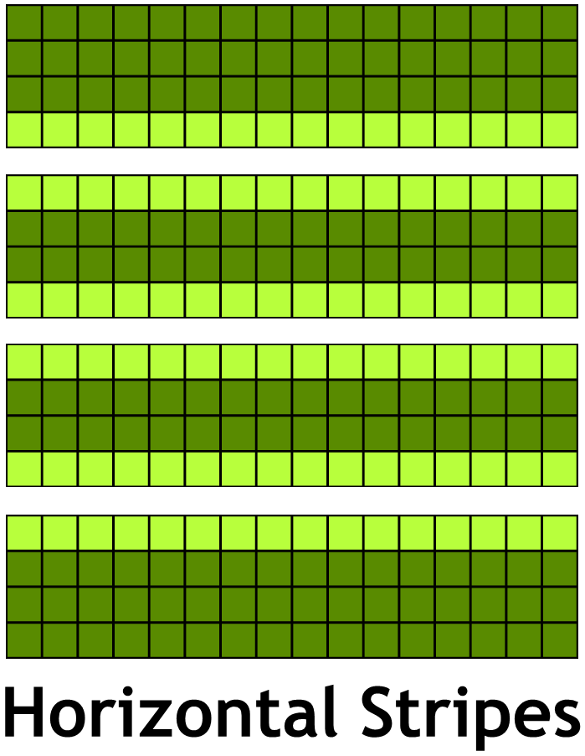
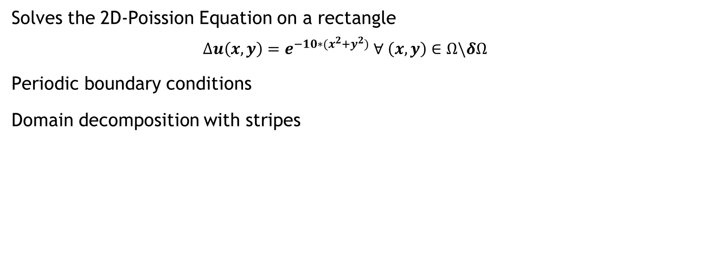
Example: Jacobi solver
Solves the 2D-Poission Equation on a rectangle
$$∆u\left(x,y\right)=e^{−10∗(x^{2}+y^{2})} ∀ \left(x,y\right)∈Ω\backslash δΩ$$
Periodic boundary conditions
Domain decomposition with stripes

Slide 14
Example: Jacobi solver
Single GPU
While not converged
Do Jacobi step:
for (int iy = 1; iy < NY-1; ++iy)
for (int ix = 1; ix < NX-1; ++ix)
Anew[iy][ix] = - 0.25f*(rhs[iy][ix] - ( A[iy][ix-1] + A[iy][ix+1]
+ A[iy-1][ix] + A[iy+1][ix]) );
Copy Anew to A
Apply periodic boundary conditions
Next iteration

Slide 15
Example: Jacobi solver
Multi GPU
While not converged
Do Jacobi step:
for (int iy = iy_start; iy < iy_end; ++iy)
for (int ix = 1; ix < NX-1; ++ix)
Anew[iy][ix] = - 0.25f*(rhs[iy][ix] - ( A[iy][ix-1] + A[iy][ix+1]
+ A[iy-1][ix] + A[iy+1][ix]) );
Copy Anew to A
Apply periodic boundary conditions and exchange halo with 2 neighbors
Next iteration

Slide 16
Example Jacobi
Top/Bottom Halo
#pragma acc host_data use_device ( A )
{
}
6/1/2016

Slide 17
Example Jacobi
Top/Bottom Halo
#pragma acc host_data use_device ( A )
{
}
MPI_Sendrecv(&A[iy_start][1], NX-2, MPI_DOUBLE, top, 0,
&A[iy_end][1], NX-2, MPI_DOUBLE, bottom, 0,
MPI_COMM_WORLD, MPI_STATUS_IGNORE);
6/1/2016

Slide 18
Example Jacobi
Top/Bottom Halo
#pragma acc host_data use_device ( A )
{
}
MPI_Sendrecv(&A[iy_start][1], NX-2, MPI_DOUBLE, top, 0,
&A[iy_end][1], NX-2, MPI_DOUBLE, bottom, 0,
MPI_COMM_WORLD, MPI_STATUS_IGNORE);
1
1
6/1/2016

Slide 19
Example Jacobi
Top/Bottom Halo
#pragma acc host_data use_device ( A )
{
}
MPI_Sendrecv(&A[iy_start][1], NX-2, MPI_DOUBLE, top, 0,
&A[iy_end][1], NX-2, MPI_DOUBLE, bottom, 0,
MPI_COMM_WORLD, MPI_STATUS_IGNORE);
2
1
MPI_Sendrecv(&A[(iy_end-1)][1], NX-2, MPI_DOUBLE, bottom, 1,
&A[(iy_start-1)][1], NX-2, MPI_DOUBLE, top, 1,
MPI_COMM_WORLD, MPI_STATUS_IGNORE);
2
1
6/1/2016

Slide 20
Handling Multi GPU nodes
GPU-affinity
#if _OPENACC
acc_device_t device_type = acc_get_device_type();
if ( acc_device_nvidia == device_type ) {
int ngpus=acc_get_num_devices(acc_device_nvidia);
int devicenum=rank%ngpus;
acc_set_device_num(devicenum,acc_device_nvidia);
}
acc_init(device_type);
#endif /*_OPENACC*/
Alternative (OpenMPI):
int devicenum = atoi(getenv("OMPI_COMM_WORLD_LOCAL_RANK"));
Alternative (MVAPICH2):
int devicenum = atoi(getenv("MV2_COMM_WORLD_LOCAL_RANK"));

Slide 21
Debugging and Profiling of MPI+OpenACC apps

Slide 22
Tools for MPI+OpenACC Applications
Memory checking: cuda-memcheck
Debugging: cuda-gdb
Profiling: nvprof and the NVIDIA Visual Profiler (nvvp)

Slide 23
Memory Checking with cuda-memcheck
cuda-memcheck is a tool similar to Valgrind’s memcheck
Can be used in a MPI environment
mpiexec -np 2 cuda-memcheck ./myapp <args>
Problem: Output of different processes is interleaved
Solution: Use save or log-file command line options
mpirun -np 2 cuda-memcheck \
--log-file name.%q{OMPI_COMM_WORLD_RANK}.log \
--save name.%q{OMPI_COMM_WORLD_RANK}.memcheck \
./myapp <args>
OpenMPI: OMPI_COMM_WORLD_RANK
MVAPICH2: MV2_COMM_WORLD_RANK

Slide 24
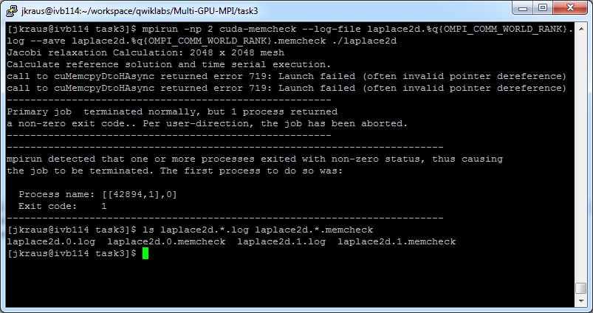
Memory Checking with cuda-memcheck

Slide 25
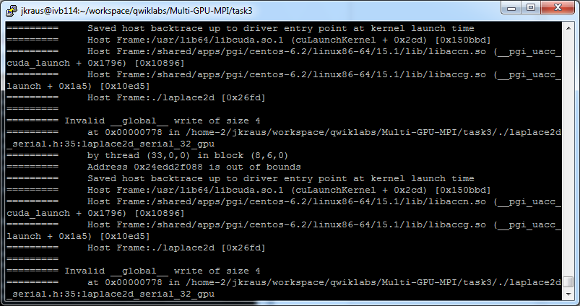
Memory Checking with cuda-memcheck
Read Output Files with cuda-memcheck --read

Slide 26
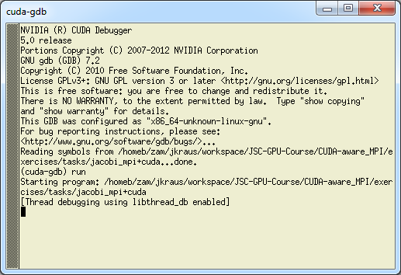
Debugging MPI+OpenACC applications
Using cuda-gdb with MPI Applications
Use cuda-gdb just like gdb
For smaller applications, just launch xterms and cuda-gdb
mpiexec -x -np 2 xterm -e cuda-gdb ./myapp <args>

Slide 27
Debugging MPI+OpenACC applications
cuda-gdb Attach
if ( rank == 0 ) {
int i=0;
printf("rank %d: pid %d on %s ready for attach\n.", rank, getpid(),name);
while (0 == i) { sleep(5); }
}
> mpiexec -np 2 ./jacobi_mpi+cuda
Jacobi relaxation Calculation: 4096 x 4096 mesh with 2 processes and one Tesla M2070 for each process (2049 rows per process).
rank 0: pid 30034 on judge107 ready for attach
> ssh judge107
jkraus@judge107:~> cuda-gdb --pid 30034

Slide 28
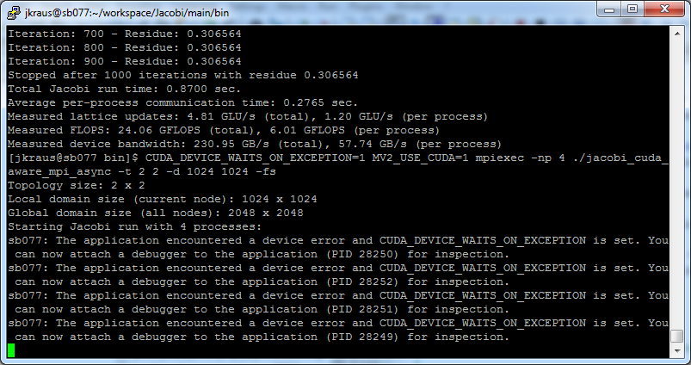
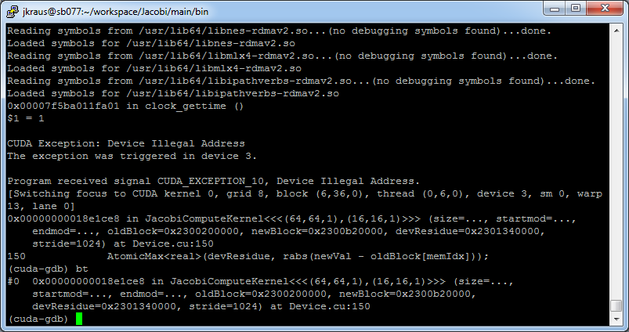
Debugging MPI+OpenACC applications
CUDA_DEVICE_WAITS_ON_EXCEPTION

Slide 29
Debugging MPI+OpenACC applications
With CUDA_ENABLE_COREDUMP_ON_EXCEPTION=1 core dumps are generated in case of an exception:
Can be used for offline debugging
Helpful if live debugging is not possible, e.g. too many nodes needed to reproduce
CUDA_ENABLE_CPU_COREDUMP_ON_EXCEPTION: Enable/Disable CPU part of core dump (enabled by default)
CUDA_COREDUMP_FILE: Specify name of core dump file
Open GPU: (cuda-gdb) target cudacore core.cuda
Open CPU+GPU: (cuda-gdb) target core core.cpu core.cuda

Slide 30
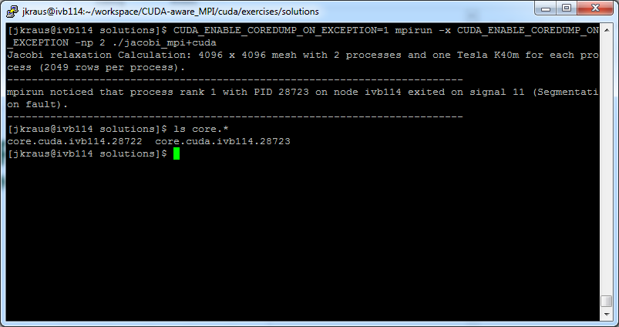
Debugging MPI+OpenACC applications
CUDA_ENABLE_COREDUMP_ON_EXCEPTION

Slide 31
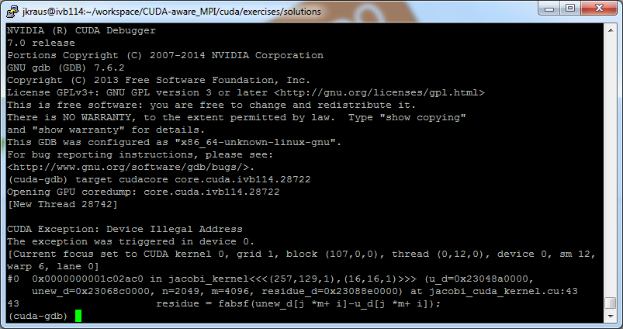
Debugging MPI+OpenACC applications
CUDA_ENABLE_COREDUMP_ON_EXCEPTION

Slide 32
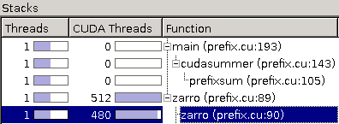
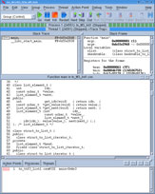
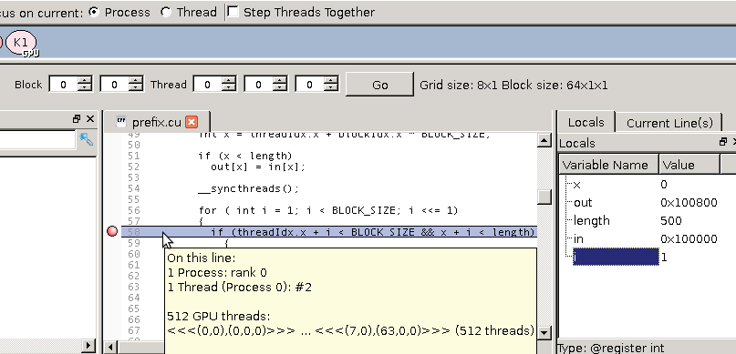
Debugging MPI+OpenACC applications
Third Party Tools
Allinea DDT debugger
Rogue Wave TotalView

Slide 33
Profiling MPI+OpenACC applications
Using nvprof+NVVP
Embed MPI rank in output filename, process name, and context name
mpirun -np $np nvprof --output-profile profile.%q{OMPI_COMM_WORLD_RANK} \
--process-name "rank %q{OMPI_COMM_WORLD_RANK}“ \
--context-name "rank %q{OMPI_COMM_WORLD_RANK}"
Alternatives:
Only save the textual output (--log-file)
Collect data from all processes that run on a node (--profile-all-processes)
New with CUDA 7.5
OpenMPI: OMPI_COMM_WORLD_RANK
MVAPICH2: MV2_COMM_WORLD_RANK

Slide 34
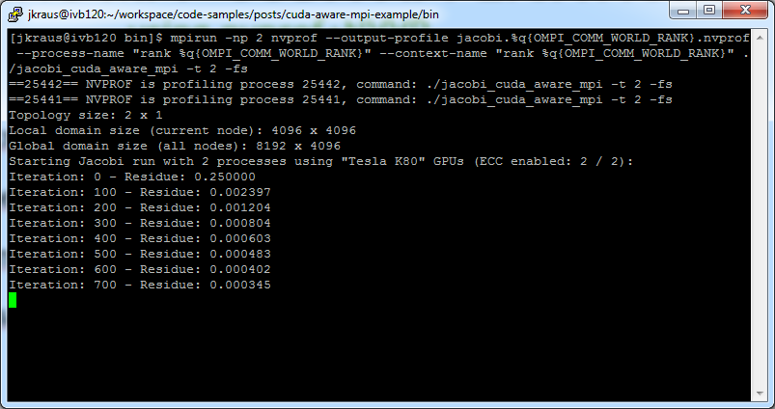
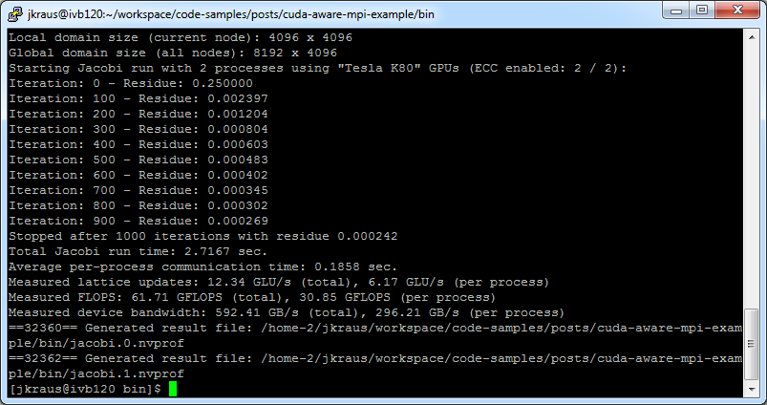
Profiling MPI+OpenACC applications
Using nvprof+NVVP

Slide 35
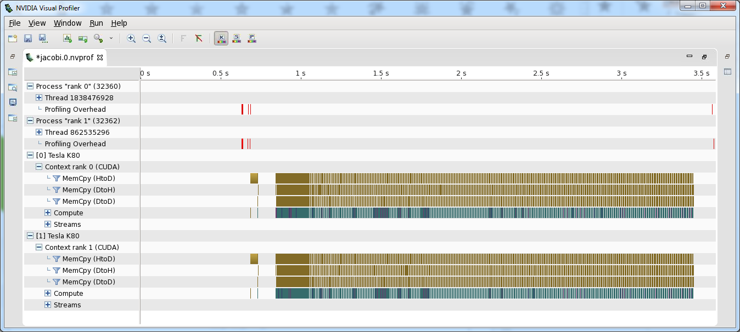
Profiling MPI+OpenACC applications
Using nvprof+NVVP
nvvp jacobi.*.nvprof
Or use the import Wizard

Slide 36
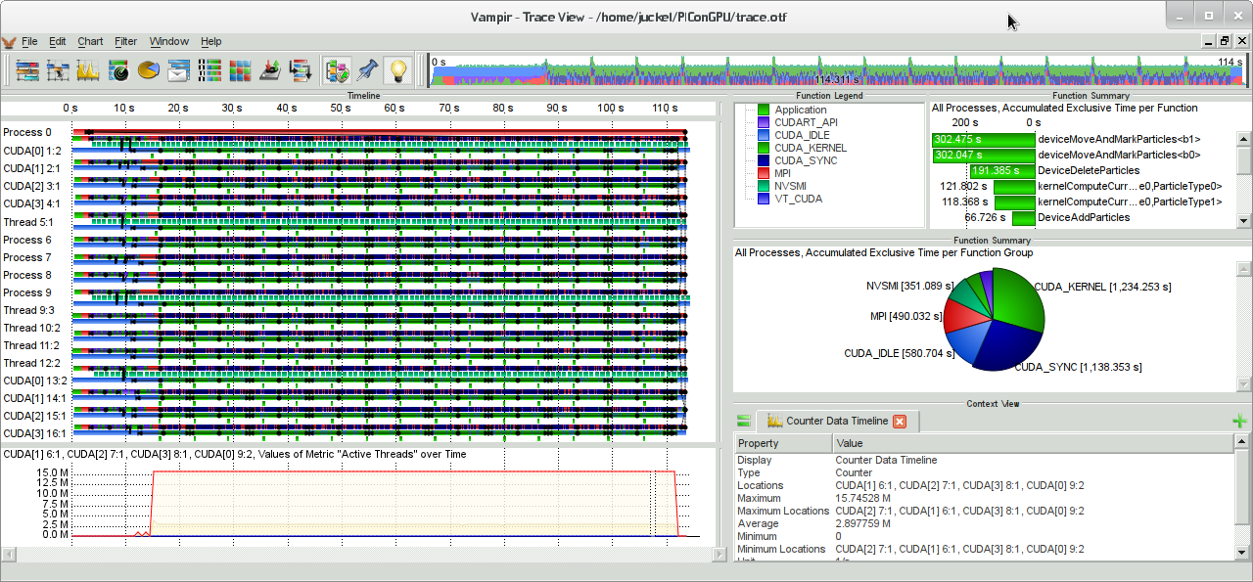
Profiling MPI+OpenACC applications
Third Party Tools
Multiple parallel profiling tools are OpenACC-aware
Score-P
Vampir
These tools are good for discovering MPI issues as well as basic OpenACC performance inhibitors.

Slide 37
Multi Process Service (MPS)

Slide 38
GPU acceleration of Legacy MPI Apps
Typical legacy application
MPI parallel
Single or few threads per MPI rank (e.g. OpenMP)
Running with multiple MPI ranks per node
GPU acceleration in phases
Proof of concept prototype, …
Great speedup at kernel level
Application performance misses expectations

Slide 39
MULTI Process Service (MPS)
For Legacy MPI Applications
GPU parallelizable part
CPU parallel part
Serial part
N=1
Multicore CPU only

Slide 40
MULTI Process Service (MPS)
For Legacy MPI Applications
GPU parallelizable part
CPU parallel part
Serial part
N=1
N=2
Multicore CPU only

Slide 41
MULTI Process Service (MPS)
For Legacy MPI Applications
GPU parallelizable part
CPU parallel part
Serial part
N=1
N=2
N=4
Multicore CPU only

Slide 42
MULTI Process Service (MPS)
For Legacy MPI Applications
GPU parallelizable part
CPU parallel part
Serial part
N=1
N=2
N=4
N=8
Multicore CPU only

Slide 43
MULTI Process Service (MPS)
For Legacy MPI Applications
GPU parallelizable part
CPU parallel part
Serial part
N=1
N=2
N=4
N=8
N=1
Multicore CPU only
GPU-accelerated

Slide 44
MULTI Process Service (MPS)
For Legacy MPI Applications
GPU parallelizable part
CPU parallel part
Serial part
With Hyper-Q/MPS
Available on Tesla/Quadro with CC 3.5+
(e.g. K20, K40, K80, M40,…)
N=1
N=2
N=4
N=8
N=1
N=2
N=4
N=8
Multicore CPU only
GPU-accelerated

Slide 45
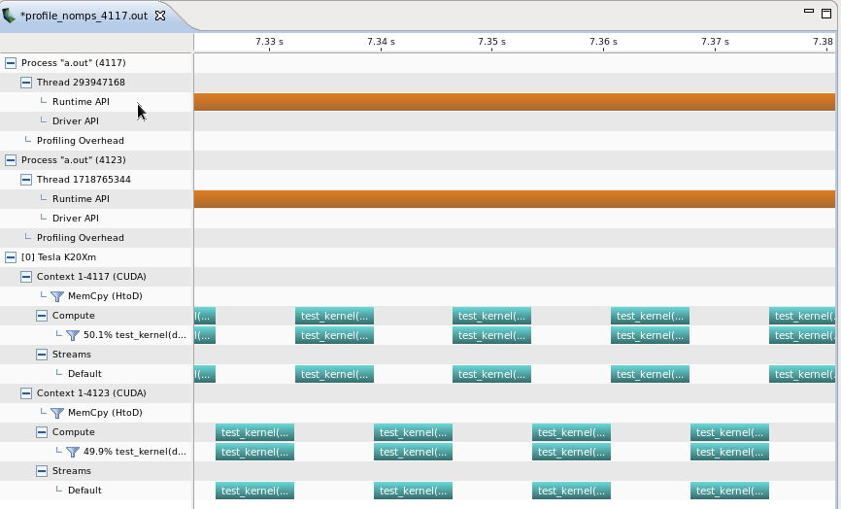
Processes sharing GPU without MPS
No Overlap
Process A
Process B
Context A
Context B
GPU
Process A
Process B

Slide 46
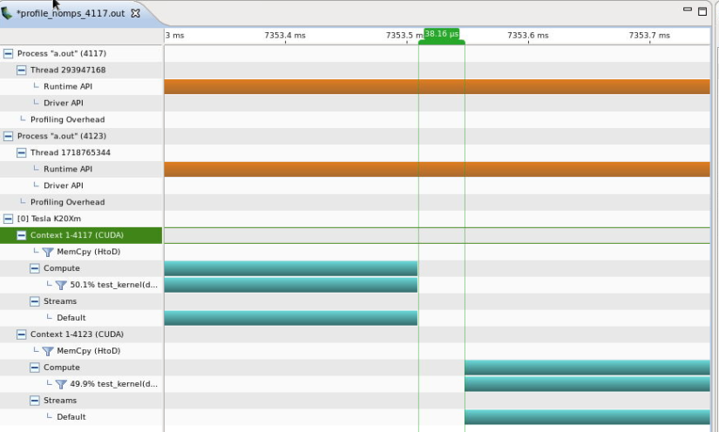

Processes sharing GPU without MPS
Context Switch Overhead
Time-slided use of GPU
Context switch
Context Switch

Slide 47
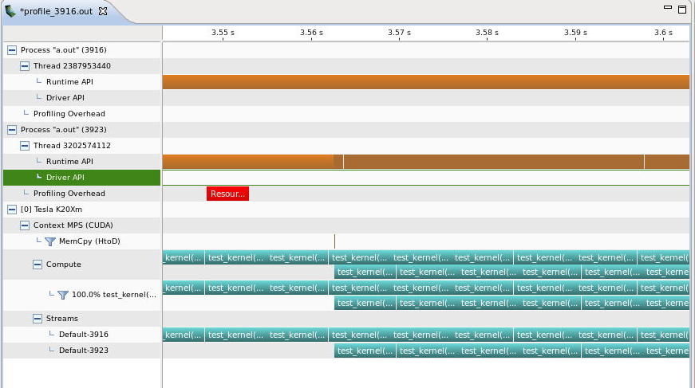
Processes sharing GPU with MPS
Maximum Overlap
Process A
Process B
Context A
Context B
MPS Process
GPU
Kernels from Process A
Kernels from Process B

Slide 48
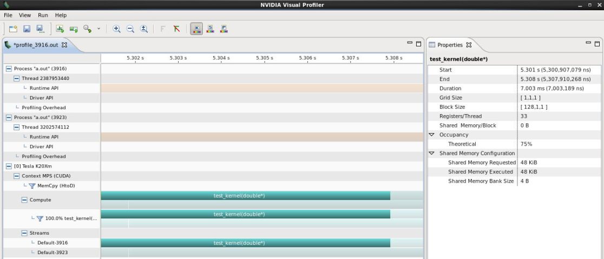
Processes sharing GPU with MPS
No Context Switch Overhead

Slide 49
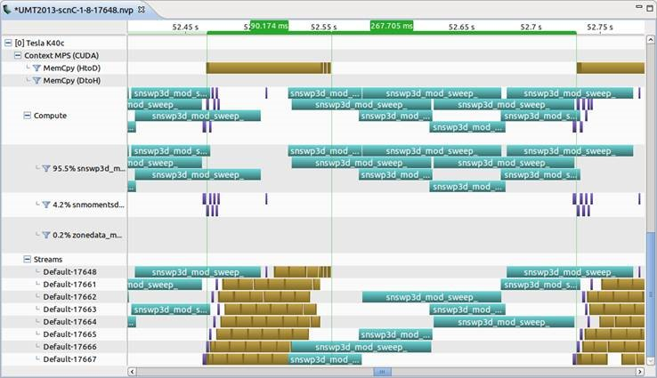
Hyper-Q/MPS Case Study: UMT
Enables overlap between copy and compute of different processes
GPU sharing between MPI ranks increases utilization

Slide 50
Hyper-Q/MPS Case Studies
CPU Scaling Speedup
Notes:
HACC (Hardware Accelerated Cosmology Codes): 8 ranks, Speedup comes from 1) now the host is work is parallel and thus we spend less time in the host work. 2) The GPU automatically overlaps communication and computation. 3) An individual rank doesn’t have enough work to saturate the GPU but with MPS multiple ranks share the GPU and the GPU is saturated.
MP2C (Multiparticle collision dynamics (MD)): 16 ranks, Speedup caused by using all CPU resources for parallel CPU work and overlapping GPU work of different MPI ranks.
VASP 5.2.12(Vienna Ab initio simulation package. Quantum mechanical MD code.): 6 ranks,
ENZO (Adaptive mesh refinement grid-based hybrid code (hydro + N-Body) used to simulate cosmological phenomena): 4 ranks, Speedup caused by using all CPU resources for parallel CPU work and overlapping GPU work of different MPI ranks.
UMT (Unstructured-Mesh deterministic radiation Transport – UMT2013): 2 ranks, Speedup comes from 1) now the host is work is parallel and thus we spend less time in the host work. 2) The GPU automatically overlaps communication and computation. 3) An individual rank doesn’t have enough work to saturate the GPU but with MPS multiple ranks share the GPU and the GPU is saturated.

Slide 51
Hyper-Q/MPS Case Studies
Additional Speedup with MPS
Notes:
HACC (Hardware Accelerated Cosmology Codes): 8 ranks, Speedup comes from 1) now the host is work is parallel and thus we spend less time in the host work. 2) The GPU automatically overlaps communication and computation. 3) An individual rank doesn’t have enough work to saturate the GPU but with MPS multiple ranks share the GPU and the GPU is saturated.
MP2C (Multiparticle collision dynamics (MD)): 16 ranks, Speedup caused by using all CPU resources for parallel CPU work and overlapping GPU work of different MPI ranks.
VASP 5.2.12(Vienna Ab initio simulation package. Quantum mechanical MD code.): 6 ranks,
ENZO (Adaptive mesh refinement grid-based hybrid code (hydro + N-Body) used to simulate cosmological phenomena): 4 ranks, Speedup caused by using all CPU resources for parallel CPU work and overlapping GPU work of different MPI ranks.
UMT (Unstructured-Mesh deterministic radiation Transport – UMT2013): 2 ranks, Speedup comes from 1) now the host is work is parallel and thus we spend less time in the host work. 2) The GPU automatically overlaps communication and computation. 3) An individual rank doesn’t have enough work to saturate the GPU but with MPS multiple ranks share the GPU and the GPU is saturated.

Slide 52
Using MPS
No application modifications necessary
Not limited to MPI applications
MPS control daemon
Spawn MPS server upon CUDA application startup
#Typical Setup
nvidia-smi -c EXCLUSIVE_PROCESS
nvidia-cuda-mps-control –d
#On Cray XK/XC systems
export CRAY_CUDA_MPS=1

Slide 53
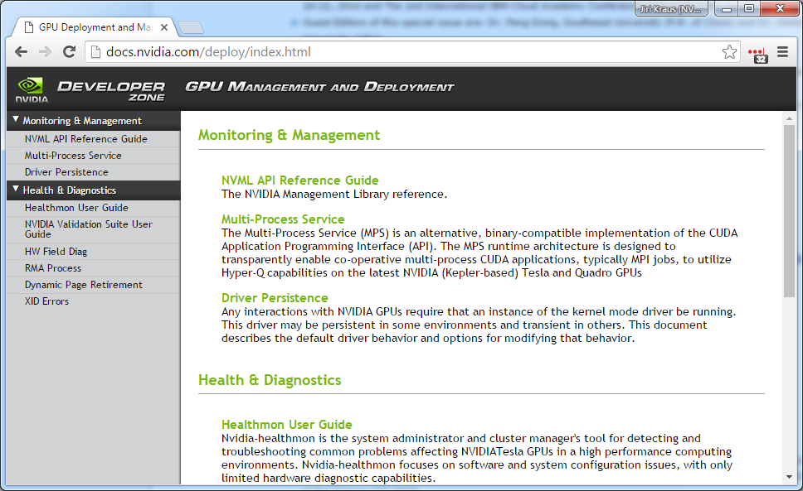
MPS Summary
Easy path to get GPU acceleration for legacy applications
Enables overlapping of memory copies and compute between different MPI ranks
Remark: MPS adds some overhead!

Slide 54
Decreasing parallel overhead

Slide 55
communication + computation overlap
OpenMPI 1.10.2 - 4 Tesla K80

Slide 56
communication + computation overlap
No Overlap
Process Whole Domain
MPI
Boundary and inner domain processing can overlap
Overlap
Process inner domain
Possible gain
Process boundary domain
MPI
Dependency

Slide 57
communication + computation overlap
OpenACC with Async Queues
#pragma acc kernels present ( A, Anew )
for ( ... )
//Process boundary
#pragma acc kernels present ( A, Anew ) async
for ( ... )
//Process inner domain
#pragma acc host_data use_device ( A ) {
MPI_Sendrecv( &A[iy_start][ix_start], (ix_end-ix_start), MPI_DOUBLE, top , 0,
&A[iy_end][ix_start], (ix_end-ix_start), MPI_DOUBLE, bottom, 0,
MPI_COMM_WORLD, MPI_STATUS_IGNORE );
MPI_Sendrecv( &A[(iy_end-1)][ix_start], (ix_end-ix_start), MPI_DOUBLE, bottom, 0,
&A[(iy_start-1)][ix_start], (ix_end-ix_start), MPI_DOUBLE, top , 0,
MPI_COMM_WORLD, MPI_STATUS_IGNORE ); }
#pragma acc wait //wait for iteration to finish

Slide 58
communication + computation overlap
OpenMPI 1.10.2 - 4 Tesla K80

Slide 59
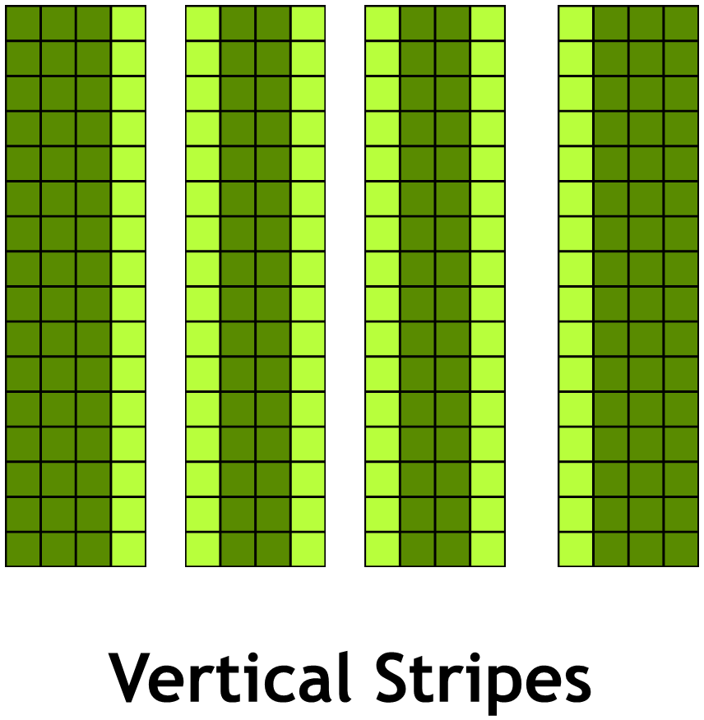
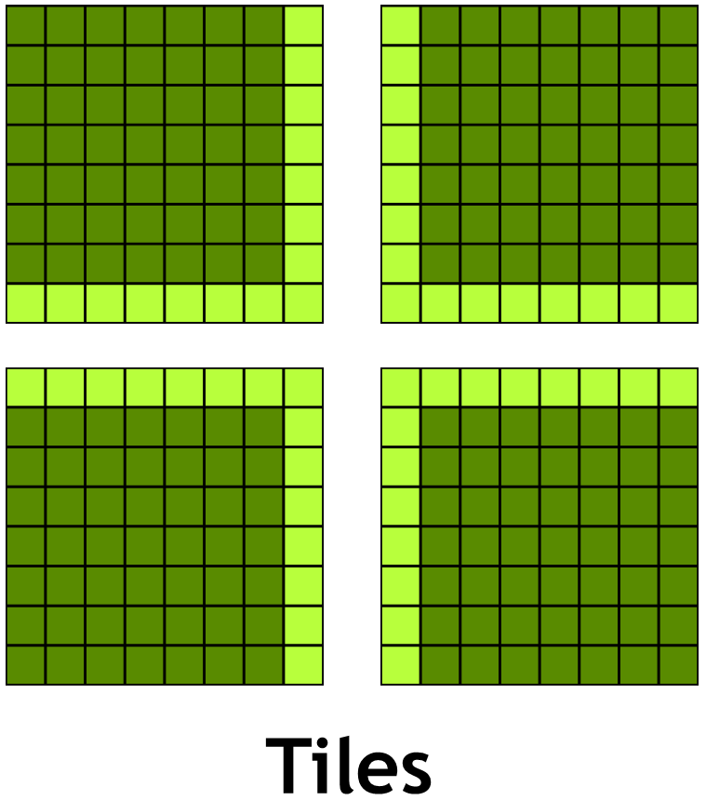
Domain Decomposition Strategies
Using stripes (2D)/planes(3D)
Minimizes the number of neighbors
Avoids noncontiguous halo exchange
Good for latency bound problems
Using tiles (2D)/using boxes (3D)
Minimizes surface to volume ratio
Requires noncontiguous halo exchange
Good for bandwidth bound problems

Slide 60
Example: Jacobi solver
Multi GPU with tiled domain decomposition
While not converged
Do Jacobi step:
for (int iy = iy_start; iy < iy_end; ++iy)
for (int ix = ix_start; ix < ix_end; ++ix)
Anew[iy][ix] = - 0.25f*(rhs[iy][ix] - ( A[iy][ix-1] + A[iy][ix+1]
+ A[iy-1][ix] + A[iy+1][ix]) );
Copy Anew to A
Exchange halo with 4 neighbors (ring exchange implicitly handles periodic boundary conditions)
Next iteration

Slide 61
Domain Decomposition with Tiles
Handling Tile <-> GPU/MPI Rank affinity

Slide 62
Domain Decomposition with Tiles
Handling Tile <-> GPU/MPI Rank affinity
(0,0)
(0,1)
(0,2)
(1,0)
(1,1)
(1,2)
(2,0)
(2,1)
(2,2)

Slide 63
Domain Decomposition with Tiles
Handling Tile <-> GPU/MPI Rank affinity
(0,0)
(0,1)
(0,2)
0
1
2
int rank = 0;
int size = 1;
MPI_Comm_rank(MPI_COMM_WORLD,&rank);
MPI_Comm_size(MPI_COMM_WORLD,&size);
(1,0)
(1,1)
(1,2)
3
4
5
(2,0)
(2,1)
(2,2)
6
7
8

Slide 64
Domain Decomposition with Tiles
Handling Tile <-> GPU/MPI Rank affinity
(0,0)
(0,1)
(0,2)
0
1
2
int rank = 0;
int size = 1;
MPI_Comm_rank(MPI_COMM_WORLD,&rank);
MPI_Comm_size(MPI_COMM_WORLD,&size);
(1,0)
(1,1)
(1,2)
3
4
5
?
(2,0)
(2,1)
(2,2)
6
7
8

Slide 65
Domain Decomposition with Tiles
Handling Tile <-> GPU/MPI Rank affinity
(0,0)
(0,1)
(0,2)
0
1
2
int rank = 0;
int size = 1;
MPI_Comm_rank(MPI_COMM_WORLD,&rank);
MPI_Comm_size(MPI_COMM_WORLD,&size);
(1,0)
(1,1)
(1,2)
3
4
5
?
(2,0)
(2,1)
(2,2)
MPI_Cart_create and MPI_Cart_shift
6
7
8

Slide 66
Domain Decomposition with Tiles
Handling Tile <-> GPU/MPI Rank affinity

Slide 67
Domain Decomposition with Tiles
Handling Tile <-> GPU/MPI Rank affinity
Determine Ranks in x direction and y direction:
int size = 1;
MPI_Comm_size(MPI_COMM_WORLD,&size);
int sizex = 3;
int sizey = size/sizex;
assert(sizex*sizey == size);

Slide 68
Domain Decomposition with Tiles
Handling Tile <-> GPU/MPI Rank affinity
Determine Ranks in x direction and y direction:
Map 1D MPI rank to 2D MPI ranks
int size = 1;
MPI_Comm_size(MPI_COMM_WORLD,&size);
int sizex = 3;
int sizey = size/sizex;
assert(sizex*sizey == size);

Slide 69
Domain Decomposition with Tiles
Handling Tile <-> GPU/MPI Rank affinity
Determine Ranks in x direction and y direction:
Map 1D MPI rank to 2D MPI ranks
int size = 1;
MPI_Comm_size(MPI_COMM_WORLD,&size);
int sizex = 3;
int sizey = size/sizex;
assert(sizex*sizey == size);
0
->
(0,0)
1
->
(0,1)
2
->
(0,2)
3
->
(1,0)
4
->
(1,1)
5
->
(1,2)
int rank = 0;
MPI_Comm_rank(MPI_COMM_WORLD,&rank);
int rankx = rank%sizex;
int ranky = rank/sizex;
6
->
(2,0)
7
->
(2,1)
8
->
(2,2)

Slide 70
Domain Decomposition with Tiles
Handling Tile <-> GPU/MPI Rank affinity
(0,0)
->
0
(0,1)
->
1
(0,2)
->
2
(1,0)
->
3
(1,1)
->
4
(1,2)
->
5
(2,0)
->
6
(2,1)
->
7
(2,2)
->
8

Slide 71
Domain Decomposition with Tiles
Handling Tile <-> GPU/MPI Rank affinity
Determine neighbors in y direction:
(0,0)
->
0
(0,1)
->
1
(0,2)
->
2
int lefty = (ranky == 0) ? (sizey-1) : ranky-1;
int righty = (ranky == (sizey-1)) ? 0 : ranky+1;
(1,0)
->
3
(1,1)
->
4
(1,2)
->
5
(2,0)
->
6
(2,1)
->
7
(2,2)
->
8

Slide 72
Domain Decomposition with Tiles
Handling Tile <-> GPU/MPI Rank affinity
Determine neighbors in y direction:
Map 2D MPI rank to 1D MPI ranks
(0,0)
->
0
(0,1)
->
1
(0,2)
->
2
int lefty = (ranky == 0) ? (sizey-1) : ranky-1;
int righty = (ranky == (sizey-1)) ? 0 : ranky+1;
(1,0)
->
3
(1,1)
->
4
(1,2)
->
5
int left = lefty * sizex + rankx;
int right = righty * sizex + rankx;
(2,0)
->
6
(2,1)
->
7
(2,2)
->
8

Slide 73
Example: Jacobi
Left/Right Halo
//right neighbor omitted
#pragma acc kernels present ( A, to_left )
for (int iy = iy_start; iy < iy_end; iy++)
to_left[iy] = A[iy][ix_start];
#pragma acc host_data use_device ( from_right, to_left ) {
MPI_Sendrecv( to_left, NY-2, MPI_DOUBLE, left, 0,
from_right, NY-2, MPI_DOUBLE, right, 0,
MPI_COMM_WORLD, MPI_STATUS_IGNORE );
}
#pragma acc kernels present ( A, from_right )
for (int iy = iy_start; iy < iy_end; iy++)
A[iy][ix_end] = from_right[iy];

Slide 74
Homework

Slide 75
Access to Homework
Qwiklabs: Getting access
Go to https://developer.nvidia.com/qwiklabs-signup
Use OPENACC promo code to register and get free access
Receive a confirmation email with access instructions
Take ‘Advanced Multi GPU Programming with MPI and OpenACC’ lab: http://bit.ly/oaccnvlab7
Questions?
Email to openacc@nvidia.com

Slide 76
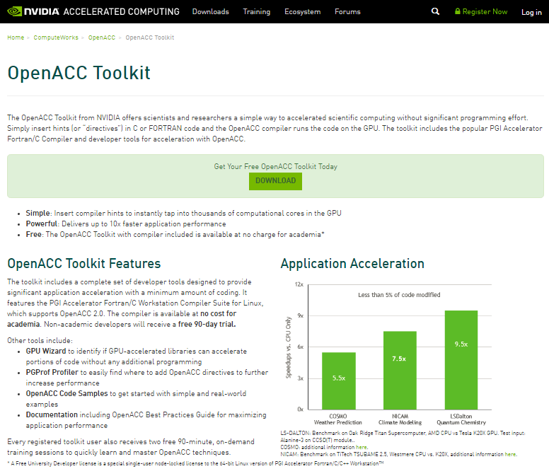
Install the OpenACC Toolkit (Optional)
Go to developer.nvidia.com/openacc-toolkit
Register for the OpenACC Toolkit
Install on your personal machine (Linux Only)
Free workstation license for academia/90 day free trial for the rest

Slide 77
May 19: Advanced Profiling of OpenACC Code
May 26: Office Hours
June 2: Advanced multi-GPU Programming with MPI and OpenACC
Course Syllabus
Recordings:
https://developer.nvidia.com/openacc-advanced-course
Questions? Email openacc@nvidia.com

Slide 78
CUDA-aware MPI implementation details

Slide 79


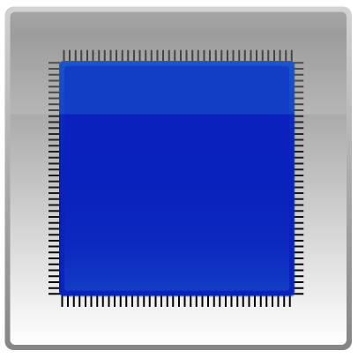


Unified Virtual Addressing
No UVA: Separate Address Spaces
UVA: Single Address Space
System
Memory
GPU
Memory
System
Memory
GPU
Memory
0x0000
0x0000
0x0000
0xFFFF
0xFFFF
0xFFFF
CPU
GPU
CPU
GPU
PCI-e
PCI-e
Notes:
So what is UVA? Unified Virtual Addressing or was introduced with CUDA 4. With UVA the System Memory and all GPUs in a single system share one large memory space. Why this is important for CUDA-aware MPI will be explained next.

Slide 80
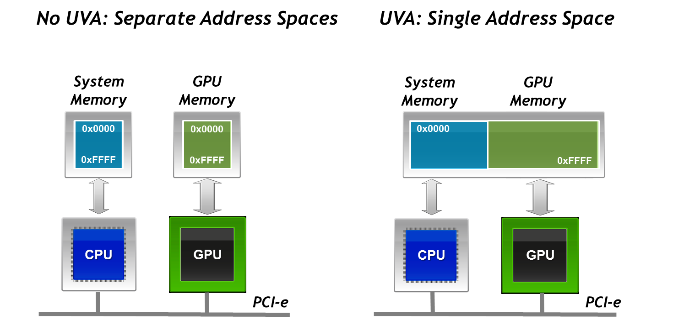
Unified Virtual Addressing
One address space for all CPU and GPU memory
Determine physical memory location from a pointer value
Enable libraries to simplify their interfaces (e.g. MPI and cudaMemcpy)
Supported on devices with compute capability 2.0+ for
64-bit applications on Linux and Windows (+TCC)
Notes:
UVA allows to determine the physical memory location from a pointer value. So speaking of MPI applications in this setup it is quite obvious that different things need to be done depending on where a buffer resides that is passed to an MPI call. To given an example the used MPI implementation might use a internal pinned buffer in system memory where all data needs to be staged through before getting send over the network device. In the case of a buffer residing in system memory a memcpy of the buffer passed to the MPI method is needed, while we would need to do a cudaMemcpy in the case that the buffer resides in device memory. If we don’t want to have different APIs for device buffer MPI and host buffer MPI the MPI implementation needs to decide if it needs to do a memcpy or a cudaMemcpy to stage the message buffer to its internal buffer.
Before I proceed let me give you a short recap about pinned and page able memory. Host memory allocated with malloc is usually pageabel, i.e. the memory pages associate with the memory can be moved around by the kernel, e.g. to the swap partition on the harddrive. As DMA and RDMA transfers work independently of the CPU and thus also the kernel they need to rely that the memory pages are not moved away by the kernel while they are operating on them. Inhibiting the movement of memory pages is called memory pinning. So memory that can not be moved around by the kernel and thus can be used in DMA and RDMA transfers is called pinned memory.
Additional Remarks (none-speaker text):
UVA requires 64bit Linux or Windows and TCC driver mode on Windows.

Slide 81

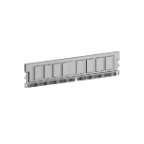


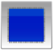
NVIDIA GPUDirect™
Accelerated Communication with Network & Storage Devices
GPU1
Memory
GPU2
Memory
System
Memory
CPU
GPU1
GPU2
PCI-e
Chip
set
IB
Notes:
Additional Remarks (not speaker text):
Accelerated Communication with Network & Storage Devices (aka GPUDirect 1.0): Direct access to CUDA memory for 3rd party devices, Eliminates unnecessary memory copies & CPU overhead, Supported by Mellanox and Qlogic, CUDA 3.1 and later. It refers to the fact that the CUDA driver and the IB driver are able to share pages so that both drivers can do DMA/RDMA transfers on these pages which avoids an unnecessary copy within the host memory.
Peer-to-Peer Communication between GPUs (aka GPUDirect 2.0): Peer-to-Peer memory access, transfers & synchronization, Less code, higher programmer productivity, CUDA 4.0 and later. It refers to P2P Transfers between GPUs within one system sitting on the same IOH Chip. This avoids staging through the host memory.
RDMA: Direct communication between GPUs across a cluster, Significantly increased MPISendRecv efficiency, CUDA 5.0 and later. It refers to P2P Transfers between GPUs in different systems connected via Infiniband network. I guess that it is necessary that the GPU and the IB card are connected to the same IOH Chip for this to work. This avoid stating through the host memory.

Slide 82
NVIDIA GPUDirect™
Peer to Peer Transfers
GPU1
Memory
GPU2
Memory
System
Memory
CPU
GPU1
GPU2
PCI-e
Chip
set
IB
Notes:
Additional Remarks (not speaker text):
Accelerated Communication with Network & Storage Devices (aka GPUDirect 1.0): Direct access to CUDA memory for 3rd party devices, Eliminates unnecessary memory copies & CPU overhead, Supported by Mellanox and Qlogic, CUDA 3.1 and later. It refers to the fact that the CUDA driver and the IB driver are able to share pages so that both drivers can do DMA/RDMA transfers on these pages which avoids an unnecessary copy within the host memory.
Peer-to-Peer Communication between GPUs (aka GPUDirect 2.0): Peer-to-Peer memory access, transfers & synchronization, Less code, higher programmer productivity, CUDA 4.0 and later. It refers to P2P Transfers between GPUs within one system sitting on the same IOH Chip. This avoids staging through the host memory.
RDMA: Direct communication between GPUs across a cluster, Significantly increased MPISendRecv efficiency, CUDA 5.0 and later. It refers to P2P Transfers between GPUs in different systems connected via Infiniband network. I guess that it is necessary that the GPU and the IB card are connected to the same IOH Chip for this to work. This avoid stating through the host memory.

Slide 83
NVIDIA GPUDirect™
Support for RDMA
GPU1
Memory
GPU2
Memory
System
Memory
CPU
GPU1
GPU2
PCI-e
Chip
set
IB
Notes:
Additional Remarks (not speaker text):
Accelerated Communication with Network & Storage Devices (aka GPUDirect 1.0): Direct access to CUDA memory for 3rd party devices, Eliminates unnecessary memory copies & CPU overhead, Supported by Mellanox and Qlogic, CUDA 3.1 and later. It refers to the fact that the CUDA driver and the IB driver are able to share pages so that both drivers can do DMA/RDMA transfers on these pages which avoids an unnecessary copy within the host memory.
Peer-to-Peer Communication between GPUs (aka GPUDirect 2.0): Peer-to-Peer memory access, transfers & synchronization, Less code, higher programmer productivity, CUDA 4.0 and later. It refers to P2P Transfers between GPUs within one system sitting on the same IOH Chip. This avoids staging through the host memory.
RDMA: Direct communication between GPUs across a cluster, Significantly increased MPISendRecv efficiency, CUDA 5.0 and later. It refers to P2P Transfers between GPUs in different systems connected via Infiniband network. I guess that it is necessary that the GPU and the IB card are connected to the same IOH Chip for this to work. This avoid stating through the host memory.

Slide 84
CUDA-aware MPI
Example:
MPI Rank 0 MPI_Send from GPU Buffer
MPI Rank 1 MPI_Recv to GPU Buffer
Show how CUDA+MPI works in principle
Depending on the MPI implementation, message size, system setup, … situation might be different
Two GPUs in two nodes
Notes:
To explain how a CUDA-aware MPI can make use of these acceleration technologies I have chosen a simple inter-node communication example; a send from one GPU Buffer and a receive to a GPU Buffer in a remote node. This shows how CUDA(-aware) MPI works in principle. Depending on the MPI implementation, message size, system setup, and so on the situation might be different.

Slide 85
CUDA-aware MPI
GPU Buffer
PCI-E DMA
Host Buffer
Pinned CUDA Buffer
Pinned IB Buffer
memcpy
RDMA
Notes:
On the following slides I use differently colored boxes and arrows to visualize different buffers and memcopy or DMA/RDMA operations. On these slides a green box is a GPU Buffer, a blue box a regular pagable host buffer, a yellow box a pinned CUDA buffer in host memory and a red box a pinned network fabric buffer in host memory. A green arrow is DMA transfer over the PCI-E bus, a blue arrow is a regular memcpy within hostmemory and a red arrow is RDMA network message.

Slide 86
MPI GPU to Remote GPU
Support for RDMA
MPI Rank 0
MPI Rank 1
GPU
Host
MPI_Send(s_buf_d,size,MPI_CHAR,1,tag,MPI_COMM_WORLD);
MPI_Recv(r_buf_d,size,MPI_CHAR,0,tag,MPI_COMM_WORLD,&stat);
MPI_Send(s_buf_d,size,MPI_CHAR,1,tag,MPI_COMM_WORLD);
MPI_Recv(r_buf_d,size,MPI_CHAR,0,tag,MPI_COMM_WORLD,&stat);
MPI_Send(s_buf_d,size,MPI_CHAR,1,tag,MPI_COMM_WORLD);
MPI_Recv(r_buf_d,size,MPI_CHAR,0,tag,MPI_COMM_WORLD,&stat);
Notes:
If GPUDirect Support for RDMA is available and we are using a CUDA-aware MPI the send buffer can be directly moved to the network and from there to the destination gpu memory without any staging through intermediate buffers.
Remarks (not speaker text):
The API calls in bold show which function is involved in the currently highlighted data movement.

Slide 87
MPI GPU to Remote GPU
Support for RDMA
MPI_Sendrecv
Time
Notes:
Depending on the message size this might happen in chunks and gives us a efficient pipeline like this.

Slide 88
Regular MPI GPU to Remote GPU
MPI Rank 0
MPI Rank 1
GPU
Host
cudaMemcpy(s_buf_h,s_buf_d,size,cudaMemcpyDeviceToHost);
MPI_Send(s_buf_h,size,MPI_CHAR,1,tag,MPI_COMM_WORLD);
MPI_Recv(r_buf_h,size,MPI_CHAR,0,tag,MPI_COMM_WORLD,&stat);
cudaMemcpy(r_buf_d,r_buf_h,size,cudaMemcpyHostToDevice);
cudaMemcpy(s_buf_h,s_buf_d,size,cudaMemcpyDeviceToHost);
MPI_Send(s_buf_h,size,MPI_CHAR,1,tag,MPI_COMM_WORLD);
MPI_Recv(r_buf_h,size,MPI_CHAR,0,tag,MPI_COMM_WORLD,&stat);
cudaMemcpy(r_buf_d,r_buf_h,size,cudaMemcpyHostToDevice);
cudaMemcpy(s_buf_h,s_buf_d,size,cudaMemcpyDeviceToHost);
MPI_Send(s_buf_h,size,MPI_CHAR,1,tag,MPI_COMM_WORLD);
MPI_Recv(r_buf_h,size,MPI_CHAR,0,tag,MPI_COMM_WORLD,&stat);
cudaMemcpy(r_buf_d,r_buf_h,size,cudaMemcpyHostToDevice);
cudaMemcpy(s_buf_h,s_buf_d,size,cudaMemcpyDeviceToHost);
MPI_Send(s_buf_h,size,MPI_CHAR,1,tag,MPI_COMM_WORLD);
MPI_Recv(r_buf_h,size,MPI_CHAR,0,tag,MPI_COMM_WORLD,&stat);
cudaMemcpy(r_buf_d,r_buf_h,size,cudaMemcpyHostToDevice);
cudaMemcpy(s_buf_h,s_buf_d,size,cudaMemcpyDeviceToHost);
MPI_Send(s_buf_h,size,MPI_CHAR,1,tag,MPI_COMM_WORLD);
MPI_Recv(r_buf_h,size,MPI_CHAR,0,tag,MPI_COMM_WORLD,&stat);
cudaMemcpy(r_buf_d,r_buf_h,size,cudaMemcpyHostToDevice);
Notes:
In contrast to this if we use a Regluar MPI we first need to stage the GPU buffer to host memory which involves a intermediate CUDA pinned buffer in host memory to enable PCI-E DMA transfers. By using pinned buffers for host memory (via cudaMallocaHost) we could avoid this intermediate buffer. After staging through the intermediate pinned CUDA buffer the data is then copied to the destination host buffer of MPI Rank 0. After cudaMemcpy returns it can be passed to the MPI implementation which might again use a internal pinned buffer to utilize RDMA capabilites of the network fabric. After staging through this buffer sending over the network the data arrives at the corresponding pinned buffer of MPI Rank 1. From there it is moved to the user managed host buffer. And the MPI_Recv calls return at MPI Rank 1. After this a cudaMemcpy moves the data via a pinned CUDA buffer to over the PCI-E bus To the destincation GPU buffer.

Slide 89
Regular MPI GPU to Remote GPU
memcpy D->H
MPI_Sendrecv
memcpy H->D
Time
Notes:
Summariesing this leads to the following rather long pipeline which needs to be stalled because cudaMemcpy and the MPI_Send and MPI_Recv calls are separate synchronous calls.

Slide 90
MPI GPU to Remote GPU
without GPUDirect
MPI Rank 0
MPI Rank 1
GPU
Host
MPI_Send(s_buf_d,size,MPI_CHAR,1,tag,MPI_COMM_WORLD);
MPI_Recv(r_buf_d,size,MPI_CHAR,0,tag,MPI_COMM_WORLD,&stat);
MPI_Send(s_buf_d,size,MPI_CHAR,1,tag,MPI_COMM_WORLD);
MPI_Recv(r_buf_d,size,MPI_CHAR,0,tag,MPI_COMM_WORLD,&stat);
MPI_Send(s_buf_d,size,MPI_CHAR,1,tag,MPI_COMM_WORLD);
MPI_Recv(r_buf_d,size,MPI_CHAR,0,tag,MPI_COMM_WORLD,&stat);
Notes:
The final case I want to show you is if a CUDA-aware MPI is used and GPUDirect is not available, e.g. because the network fabric does not support it yet. Even in this case CUDA-aware MPI makes your MPI+CUDA program run more efficient. Compared to the regular MPI a CUDA-aware MPI can avoid the pipeline stalls after calling cudaMemcpy and the MPI_Recv and also avoids one unnecessary memory copy within host memory. It can directly move data from the pinned CUDA Buffer to the network fabric buffer.

Slide 91
MPI GPU to Remote GPU
without GPUDirect
MPI_Sendrecv
Time
Notes:
Together this leads to a shorter pipeline without stalls. Of course this pipeline could be also implemented by the user with a regular MPI. But letting the MPI do the job has serveral advantages: It leads to cleaner code that is easier to maintain and the MPI can utilize techniques like GPUDirect and possibly be more efficient for a few other aspects. Next I will present some performance results with CUDA-aware MPI.

Slide 92
Performance Results two Nodes
OpenMPI 1.10.2 MLNX FDR IB (4X) Tesla K40@875
Latency (1 Byte) | 24.99 us | 21.72 us | 5.65 us
Notes:
Regular MPI uses same CUDA-aware MPI build with pinned host staging buffers.
CPU: Xeon(R) CPU E5-2698 v3 @ 2.30GHz
$ ibstat
CA 'mlx5_0'
CA type: MT4113
Number of ports: 2
Firmware version: 10.10.4020
Hardware version: 0
Node GUID: 0xe41d2d030006adb0
System image GUID: 0xe41d2d030006adb0
Port 1:
State: Active
Physical state: LinkUp
Rate: 56
Base lid: 44
LMC: 0
SM lid: 1
Capability mask: 0x06514848
Port GUID: 0xe41d2d030006adb0
Link layer: InfiniBand
Port 2:
State: Down
Physical state: Disabled
Rate: 10
Base lid: 65535
LMC: 0
SM lid: 0
Capability mask: 0x06514848
Port GUID: 0xe41d2d030006adb8
Link layer: InfiniBand
$ nvidia-smi
Tue Mar 29 09:19:34 2016
+------------------------------------------------------+
| NVIDIA-SMI 352.68 Driver Version: 352.68 |
|-------------------------------+----------------------+----------------------+
| GPU Name Persistence-M| Bus-Id Disp.A | Volatile Uncorr. ECC |
| Fan Temp Perf Pwr:Usage/Cap| Memory-Usage | GPU-Util Compute M. |
|===============================+======================+======================|
| 0 Tesla K40m On | 0000:02:00.0 Off | 0 |
| N/A 29C P8 31W / 235W | 56MiB / 11519MiB | 0% Default |
+-------------------------------+----------------------+----------------------+
| 1 Tesla K40m On | 0000:82:00.0 Off | 0 |
| N/A 33C P8 32W / 235W | 56MiB / 11519MiB | 0% Default |
+-------------------------------+----------------------+----------------------+
| 2 Tesla K40m On | 0000:85:00.0 Off | 0 |
| N/A 32C P8 32W / 235W | 56MiB / 11519MiB | 0% Default |
+-------------------------------+----------------------+----------------------+
| 3 Tesla K40m On | 0000:86:00.0 Off | 0 |
| N/A 36C P8 33W / 235W | 56MiB / 11519MiB | 0% Default |
+-------------------------------+----------------------+----------------------+
+-----------------------------------------------------------------------------+
| Processes: GPU Memory |
| GPU PID Type Process name Usage |
|=============================================================================|
| No running processes found |
+-----------------------------------------------------------------------------+
$ nvidia-smi topo -m
GPU0 GPU1 GPU2 GPU3 mlx5_0 CPU Affinity
GPU0 X SOC SOC SOC SOC 0-15
GPU1 SOC X PHB PHB PHB 16-31
GPU2 SOC PHB X PIX PHB 16-31
GPU3 SOC PHB PIX X PHB 16-31
mlx5_0 SOC PHB PHB PHB X
Legend:
X = Self
SOC = Path traverses a socket-level link (e.g. QPI)
PHB = Path traverses a PCIe host bridge
PXB = Path traverses multiple PCIe internal switches
PIX = Path traverses a PCIe internal switch
Currently Loaded Modulefiles:
1) PrgEnv/GCC+OpenMPI/2016-02-19 5) hwloc/1.11.2
2) cuda/7.5 6) numactl/2.0.9
3) gcc/4.8.5 7) openmpi/2.0.0rc1
4) gdk/352.55

